Slide 1

Session Outcome: Understand Under the Hood: The System Call
Under the Hood system call
Xv6: read(), tvinit, mpmain(), alltraps, traps, syscall()
Understand usys.s, main.c, trap.c, mmu.h, vectors.s, trapasm.s, trap.c,traps.h, syscall.c

Slide 2
1. System Call Overview
The xv6 kernel is a port of an old UNIX version 6
In this session, we’ll examine what goes on inside an os when system call is invoked.
We’ll specifically trace what happens in the code in order to understand a system call.
how can we build a system such that the OS is allowed access to all of the resources of the machine
the computer hardware(CPU) can be in two states(well several CPU architectures have more than two states). One is generally called User-mode (less privileged mode), and the other is called Kernel-mode (privileged mode).
Generally all user processes begin with user-mode. When CPU is in user-mode, there are restrictions to what it can do, and cannot access hardware and other system resources.
And when it needs access to system resources and hardware, it issues a request to the kernel. When the CPU is in kernel-mode, there is unrestricted access to all hardware and system resources.
Upon this request, the scheduler pauses and saves the current context and then initiate to serve the request.
After completion of the request the control comes back to the previous context and resumes its execution.
The operating system can switch the CPU from one mode to another mode as and when required.
This sort of pause and resume carried out by the operating system is also sometimes called as "Context Switch".

Slide 3
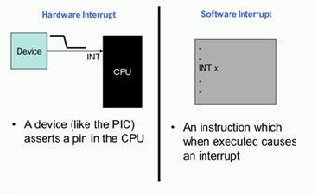
Difference between System Call and an Interrupt
A hardware interrupt is generated by a hardware attached to the system.
For example,
The printer attached to the system can generate an interrupt when it completes printing some document
device such as a keyboard or a network card could assert a particular signal in the CPU and this would cause the CPU to asynchronously execute an interrupt handler corresponding to the device.
So, this device would typically send a signal to the CPU through an intermediate device such as a PIC or a programmable interrupt controller.
In much the similar way, we have what is known as a Software Interrupt. A software interrupt is generated by a program running on the computer to get attention from the CPU.

Slide 4
However, unlike having an external device which causes the interrupt, here an instruction in the program would trigger the interrupt. In this particular case, for example, an instruction such as INT would cause the interrupt to occur and the operating system to execute.
So, here the instruction is INT x, so x here is the interrupt number. It typically has a value less than 256, and it is used to specify or distinguish between software interrupts.
So when a particular interrupt gets triggered, from the options present in the entry for that interrupt, the CPU knows which privilege level it should set for executing that interrupt handler.
System call is generally a software interrupt. So one important thing to remember is this... Both system calls and interrupts are numbered
One major difference between software interrupt and hardware interrupt is the fact that hardware interrupt can be fired at any time. For example, a user typing something on the keyboard will trigger a hardware interrupt, but software interrupt can only be triggered by something which is currently being executed(ie: currently running) by the CPU.

Slide 5
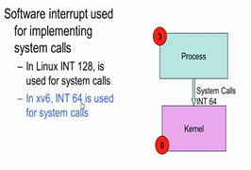
where is the software interrupt used?
Software interrupts are used to implement system calls. So, as we know a user process could invoke a system call to perform some Kernel operation. For example, it could be to read a file or to write a file, to print something to a monitor, or to send a packet through the network and so on. More specifically, all operating systems implement system calls through one particular software interrupt.
For example, in the Linux operating systems, the software interrupt 128 is used to specify system calls. Therefore, in a Linux OS, if I have a INT 128 which is executed in the user process, it would lead to an interrupt that occurs and cause the kernel or the operating system to execute, and thereafter the OS would execute code depending on the interrupt.
In xv6, the software interrupt used to implement system calls is 64 or instruction like INT 64 in the user process would be meant to implement a system call.

Slide 6
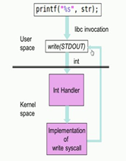
Software interrupt ..Example
So to take an example, let us consider that our application has a printf statement present in it. So, printf would print this string ‘str’ (mentioned in above image) to the standard output, which typically is the monitor. Now printf is a function present in the library libc and it would cause the libc function to be invoked. Now in the libc function there is a call to the write system call with the specifier STDOUT i.e write(STDOUT). So, the STDOUT here is the file descriptor; and it is a special file descriptor which is meant for the standard output or the monitor.
So in the write function, it would invoke INT 64 in xv6 or INT 128 in Linux and cause a software interrupt to occur. So, the software interrupt as we know would cause the transformation from the User space to the Kernel space and it would result in the operating system executing. The OS would then determine that the interrupt was in fact due to a system call and then it would determine what system call it was from; in this case, it was from a write system call and it was a write to the STDOUT - the standard output.
So the operating system would then invoke the handler for the write system call, and this handler would take care of communicating with the various devices such as the video card to display the string onto the monitor. So, after this handler completes execution, the IRET instruction is executed which would result in a transformation back from Kernel space to the User space and the program will continue to execute.

Slide 7
Different types of system calls in XV6
Now, typically operating systems support several different types of system calls. So, this particular table over here shows the various system calls supported by xv6. And you are also familiar with several types of system calls such as open(), read(), write(), close(), change directory chdir(), make directory mkdir() and so on. So, each of these system calls would be executed by having a software interrupt such as INT 64, because it is the xv6, so it is 64. So, each time any of these system calls are invoked by a user process, it would trigger the operating system to execute.
Now, the next obvious question that one would ask is from the OS perspective, how does the OS distinguish between the various system calls? So, we mention that all the system calls will use either INT 64 for xv6 and INT 128 for Linux. So how does the OS determine whether the system call was with respect to fork(), wait(), sleep(), exit(), and so on. Essentially this distinguisher comes from the user process itself.

Slide 8
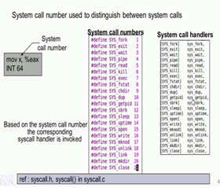
What happens is that, before the INT 64 instruction, the user process will move a system call number to the eax register. So, for example, instruction mov x, %eax will move the system call number to the eax register. Now each system call in the operating system will have a unique number, system call number. Now the operating system when triggered by the INT instruction would look up the eax register, and then determine what system call was invoked. For example, in xv6, if we look up these particular header files (mentioned in above image), we would see the various system call numbers defined. For example, we have each system call given a specific number, for example SYS_fork given 1, SYS_exit giving 2 and so on.

Slide 9
Now when the OS gets trigger due to the INT 64 instruction getting executed, the OS will determine the system call using this system call numbers and then invoke the corresponding system call handler. So, each of the system calls also have a corresponding system call handler corresponding to each of the system call numbers SYS_fork that is 1, SYS_exit it is 2 and so on.
So, these are system call functions (mentioned above in System call handler list) present in the operating system which gets triggered based on the type of the system call. For example, if eax had a value of 11, the operating system will look in to the eax register and determine that this corresponded to the getpid system call being invoked.
And then it would look into this particular table (mentioned above in System call handler list) and see that the getpid system call is handled by this function sys_getpid, and therefore it will then invoke this sys_getpid function.

Slide 10
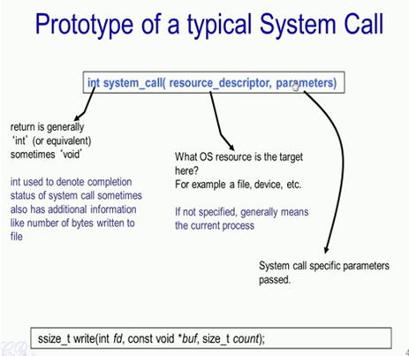
Now, let us look at the typical prototype of a system call. It has a system call name that is a function name and then it is passed some resource descriptor and parameters and typically would return an integer. So, the resource descriptor specifies what operating system resource is the target here. For example, it could be a file or a device; and as we have seen in the previous slides it could also specify a particular monitor. For example, if the resource descriptor is STDOUT then the resource in use here is the monitor.
So, some system calls also do not specify this resource descriptor; in such a case, the system call is meant for that resource itself. For example, if we use the sleep system call, we only specify the time and no specific descriptor such as the file, a device and so on. This means that the current process wants to sleep for that given interval time.
The next part is the parameters. So, these parameters are specific for the system call. For example, if we invoke read, write, open or close or any other system call, the parameters specified here is going to be very specific for each of these system calls. For example, the write system call has the parameter *buf that is a void pointer and the count. So, the open or the close or any other system call would have different set of parameters. So, essentially these parameters are very specific to the type of the system call.

Slide 11
The return type is typically int or integer, and sometimes it is a void. So, ‘int’ is typically used because in this way the operating system will be able to send the completion status of the system call, whether it had executed successfully or it had failed and so on. So, sometimes the return is also used to specify certain specific information about the system call. For example, in write the return is ssize_t which in fact, is typdef to integer and it specifies number of bytes that have been written to the file, specified int fd. So, the return type could also vary depending on the type of system call.
The next thing what we will look at:
How are the parameters such as the resource descriptor and the other parameters passed to the kernel?

Slide 12
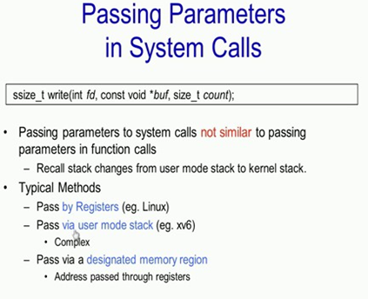
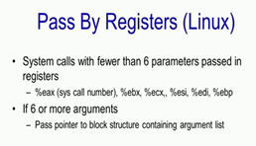
So essentially, there are three ways of doing so.
The first is by pass by registers which is typically done in Linux;
the second way is by passing through the user mode stack which is done in xv6; and
the third way is by passing through a designated memory region.
So, in this particular case (third case), what is done is that in the user process itself, a designated region most likely in the heap would be used to save the various parameters that is needed to be passed to the system call; and the address to this region in the heap is passed through the registers. So, we will look at the other two cases that is pass by registers and pass via user mode stack in more detail.
Now Pass by Registers which is used by Linux system calls would use the registers present in the processor to pass parameters to the kernel. So, we know we have already seen an example of this, of how the %eax register is used to pass the system call number from the user process to the operating system. In a similar way, other registers such as the %ebx, %ecx, %esi, %edi, and %ebp are used to pass the various parameters of the system call from the user process to the kernel. If the system call has more than 6 arguments then a pointer to a block structure containing the argument list is passed to the kernel.

Slide 13
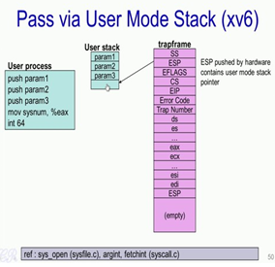
Now, let us look at the second case that is Pass via the User Mode Stack and this is what is done in xv6. So, in this particular way, before the int 64 instruction is present various parameters in the system call are pushed onto the stack. For example, if the system call had 3 parameters; param 1, param 2, and param 3, so these three parameters are pushed into the user space stack and then the system call number moved into the %eax register. So, this here is the user space stack of the user process containing the 3 parameters.
Now, when the INT instruction is executed, as we know, it triggers an interrupt causing the switch from the user space into the kernel space. Also as a result of this interrupt execution, as we have seen, there is the switch in the stack from the user space stack to the kernel space stack. This kernel stack is used to create what is known as the trapframe. Some of the entries in the trapframe are pushed into the stack automatically by the CPU. So, in particular, these registers specified in capitals letters are all pushed onto the kernel stack that is on to the trapframe by the CPU.
Now, the SS and ESP in trapframe box are the stack segment and the stack pointer, and these registers correspond to the user space stack. So, as we know before the INT 64 has been executed, the last known stack pointer was pointing to this particular location. And therefore, the contents of ESP will also point to this location in the user space stack. So, in this way, the kernel will then use the SS and the ESP from the trapframe to determine the various parameters for the system call.

Slide 14
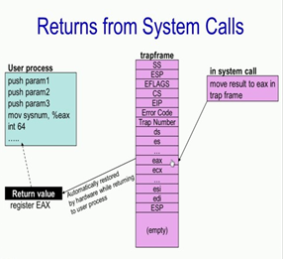
The next thing we will look at is how the return value is passed from the system call back to the user process. Again we will recollect that the entire reason for creating this trapframe in the kernel stack for the process is due to the reason that when the interrupt or the system call completes its execution, the entire state in the trapframe is restored back into the corresponding CPU registers, and it would result in the user process continuing to execute from where it had stopped, and also the context of the user process is restored with the help of the trapframe.
Now, in order to return a value from the system call which is executing in the kernel space back to the user space, so what is done is that the eax register in the trapframe is modified; essentially, we had seen that the eax register because of this particular instruction (mov sysnum, %eax) would contain the system call number.
Now this system call number is overridden by the return value of the system call. So, this could be a negative number like -1 or a positive number as we have seen in the earlier slide. So, now when the system call executes and completes its execution and the context is transferred back to the user process, the entire trapframe including the new value of eax in the trapframe is restored back in to the registers of the CPU. The process continues to execute from this particular instruction.

Slide 15
IMPLEMENTATION THROUGH XV6:
1. System Call
We need to examine the path in and out of the kernel on a system call. It is much more complex than a simple procedure call, and requires a careful protocol on behalf of the OS and hardware to ensure that application state is properly saved and restored on entry and return.
2. Getting Into The Kernel: Issuing a Trap as specified in usys.S
The first step in a system call begins at user-level with an application.
The application that wishes to make a system call (such as read()) calls the relevant library routine.
Here we can see that the read() library function actually doesn’t do much at all; it moves the value 5 into the register %eax and issues the x86 trap instruction which is called int (short for “interrupt”).
The value in %eax is going to be used by the kernel to vector to the right systemcall, i.e., it determines which system call is being invoked. The int instruction takes one argument (here it is 64) which tells the hardware which trap type this is.
In xv6, trap 64 is used to handle system calls.
Any other arguments which are passed to the system call are passed on the stack.
.globl read;
read:
movl $5, %eax;
int $64;
ret
usys.S

Slide 16
3. Kernel Side: Trap Tables
// FILE: main.c
int
main(void)
{
...
tvinit(); // trap vectors initialized here
...
}
The routine tvinit() is the relevant one here. Peeking inside of it, we see:
// FILE: trap.c
void tvinit(void)
{
int i;
for(i = 0; i < 256; i++)
SETGATE(idt[i], 0, SEG_KCODE<<3, vectors[i], 0);
// this is the line we care about...
SETGATE(idt[T_SYSCALL], 1, SEG_KCODE<<3, vectors[T_SYSCALL], DPL_USER);
initlock(&tickslock, "time");
}
Once the int instruction is executed, the hardware takes over and does a bunch of work on behalf of the caller. One important thing the hardware does is to raise the privilege level of
the CPU to kernel mode; on x86 this is usually means moving from a CPL (Current Privilege Level) of 3 (the level at which user applications run) to CPL 0 (in which the kernel runs). Yes, there are a couple of privilege levels in-between, but most systems do not make use of these.
The second important thing the hardware does is to transfer control to the trap vectors of the system. To enable the hardware to know what code to run when a particular trap occurs, the OS, when booting, must make sure to inform the hardware of the location of the code to run when such traps take place. This is done in main.c

Slide 17
3. Kernel Side: Trap Tables..contd..
The SETGATE() macro is the relevant code here. It is used to set the idt array to point to the proper code to execute when various traps and interrupts occur. For system calls, the single SETGATE() call (which comes after the loop) is the one we’re interested in. Here is what the macro does (as well as the gate
descriptor it sets):
// FILE: mmu.h
// Gate descriptors for interrupts and traps
struct gatedesc {
uint off_15_0 : 16; // low 16 bits of offset in segment
uint cs : 16; // code segment selector
uint args : 5; // # args, 0 for interrupt/trap gates
uint rsv1 : 3; // reserved(should be zero I guess)
uint type : 4; // type(STS_{TG,IG32,TG32})
uint s : 1; // must be 0 (system)
uint dpl : 2; // descriptor(meaning new) privilege level
uint p : 1; // Present
uint off_31_16 : 16; // high bits of offset in segment
};
// Set up a normal interrupt/trap gate descriptor.
// - istrap: 1 for a trap (= exception) gate, 0 for an interrupt gate.
// interrupt gate clears FL_IF, trap gate leaves FL_IF alone
// - sel: Code segment selector for interrupt/trap handler
// - off: Offset in code segment for interrupt/trap handler
// - dpl: Descriptor Privilege Level -
// the privilege level required for software to invoke
// this interrupt/trap gate explicitly using an int instruction.
#define SETGATE(gate, istrap, sel, off, d) \
{ \
(gate).off_15_0 = (uint) (off) & 0xffff; \
(gate).cs = (sel); \
(gate).args = 0; \
(gate).rsv1 = 0; \
(gate).type = (istrap) ? STS_TG32 : STS_IG32; \
(gate).s = 0; \
(gate).dpl = (d); \
(gate).p = 1; \
(gate).off_31_16 = (uint) (off) >> 16; \
}
As you can see from the code, all the SETGATE() macros does is set the values of an in-memory data structure. Most important is the off parameter, which tells the hardware where the trap handling code is. In the initialization code, the value vectors[T SYSCALL] is passed in; thus,whatever the vectors array points to will be the code to run when a system call takes place. There are other details (which are important too); consult an x86 hardware architecture manual for more information.

Slide 18
3. Kernel Side: Trap Tables..contd..
Note, however, that we still have not informed the hardware of this information, but rather filled a data structure. The actual hardware informing occurs a little later in the boot sequence; in xv6, it happens in the routine mpmain() in the file main.c:
static void
mpmain(void)
{
idtinit();
...
void
idtinit(void)
{
lidt(idt, sizeof(idt));
}
static inline void
lidt(struct gatedesc *p, int size)
{
volatile ushort pd[3];
pd[0] = size-1;
pd[1] = (uint)p;
pd[2] = (uint)p >> 16;
asm volatile("lidt (%0)" : : "r" (pd));
}
Here, you can see how (eventually) a single assembly instruction is called to tell the hardware where to find the interrupt descriptor table (IDT) in memory. Note this is done in mpmain() as each processor in the system must have such a table (they all use the same one of course).

Slide 19
3. Kernel Side: Trap Tables..contd..
struct trapframe {
// registers as pushed by pusha
uint edi;
uint esi;
uint ebp;
uint oesp; // useless & ignored
uint ebx;
uint edx;
uint ecx;
uint eax;
// rest of trap frame
ushort es;
ushort padding1;
ushort ds;
ushort padding2;
uint trapno;
// below here defined by x86 hardware
uint err;
uint eip;
ushort cs;
ushort padding3;
uint eflags;
// below here only when crossing rings, such as from user to kernel
uint esp;
ushort ss;
ushort padding4;
};
File: x86.h
The OS has carefully set up its trap handlers, and thus we are ready to see what happens on the OS side once an application issues a system call via the int instruction. Before any code is
run, the hardware must perform a number of tasks. The first thing it does are those tasks which are difficult/impossible for the software to do itself, including saving the current PC (IP or EIP in Intel terminology) onto the stack, as well as a number of other registers such as the eflags register (which contains the current status of the CPU while the program was running), stack pointer, and so forth.
One can see what the hardware is expected to save by looking at the trapframe structure as defined in x86.h.

Slide 20
4. From Low-level To The C Trap Handler
As you can see from the bottom of the trapframe structure, some pieces of the trap frame are filled in by the hardware (up to the err field); the rest will be saved by the OS. The first code OS that is run is vector64() as found in vectors.S (which is automatically generated by vectors.pl).
.globl vector64
vector64:
pushl $64
jmp alltraps
File: vectors.S (generated by vectors.pl)
This code pushes the trap number onto the stack (filling in the trapno field of the trap frame) and then calls alltraps() to do most of the saving of context into the trapframe. The code in alltraps() pushes a few more segment registers (not described here, yet) onto the stack before pushing the remaining general purpose registers onto the trap frame via a pushal instruction. Then, the OS changes the descriptor segment and extra segment registers so that it can access its own (kernel) memory. Finally, the C trap handler is called.

Slide 21
5.The C Trap Handler
Once done with the low-level details of setting up the trap frame, the low-level assembly code calls up into a generic C trap handler called trap(), which is passed a pointer to the trapframe. This trap handler is called upon all types of interrupts and traps, and thus check the trap number field of the trap frame (trapno) to determine what to do. The first check is for the system call trap number (T_SYSCALL, or 64 as defined somewhat arbitrarily in traps.h), which then handles the system call, as you see here:
# vectors.S sends all traps here.
.globl alltraps
alltraps:
# Build trap frame.
pushl %ds
pushl %es
pushal
# Set up data segments.
movl $SEG_KDATA_SEL, %eax
movw %ax,%ds
movw %ax,%es
# Call trap(tf), where tf=%esp
pushl %esp
call trap
addl $4, %esp
File: trapasm.S
// FILE: trap.c
void
trap(struct trapframe *tf)
{
if(tf->trapno == T_SYSCALL){
if(cp->killed)
exit();
cp->tf = tf;
syscall();
if(cp->killed)
exit();
return;
}
... // continues
}

Slide 22
The code isn’t too complicated. It checks if the current process (that made the system call) has been killed; if so, it simply exits and cleans up the process (and thus does not proceed with the system call). It then calls syscall() to actually perform the system call; more details on that below. Finally, it checks whether the process has been killed again before returning. Note that we’ll follow the return path below in more detail.
Void syscall(void)
{
int num;
num = cp->tf->eax;
if(num >= 0 && num < NELEM(syscalls) && syscalls[num])
cp->tf->eax = syscalls[num]();
else {
cprintf("%d %s: unknown sys call %d\n", cp->pid, cp->name, num);
cp->tf->eax = -1;
}
}
File: syscall.c

Slide 23
6 Vectoring To The System Call
static int (*syscalls[])(void) = {
[SYS_chdir] sys_chdir,
[SYS_close] sys_close,
[SYS_dup] sys_dup,
[SYS_exec] sys_exec,
[SYS_exit] sys_exit,
[SYS_fork] sys_fork,
[SYS_fstat] sys_fstat,
[SYS_getpid] sys_getpid,
[SYS_kill] sys_kill,
[SYS_link] sys_link,
[SYS_mkdir] sys_mkdir,
[SYS_mknod] sys_mknod,
[SYS_open] sys_open,
[SYS_pipe] sys_pipe,
[SYS_read] sys_read,
[SYS_sbrk] sys_sbrk,
[SYS_sleep] sys_sleep,
[SYS_unlink] sys_unlink,
[SYS_wait] sys_wait,
[SYS_write] sys_write,
};
Once we finally get to the syscall() routine in syscall.c, not much work is left to do.
The system call number has been passed to us in the register %eax, and now we unpack that number from the trap frame and use it to call the appropriate routine as defined in the system call table syscalls[].
Pretty much all operating systems have a table similar to this to define the various system calls they support. After carefully checking that the system call number is in bounds, the pointed to routine is called to handle the call. For example, if the system call read() was called by the user, the routine sys read() will be invoked here.
The return value, you might note, is stored in %eax to pass back to the user.
The return path is pretty easy. First, the system call returns an integer value, which the code in syscall() grabs and places into the eax field of the trapframe. The code then returns into trap(), which simply returns into where it was called from in the assembly trap handler.

Slide 24
7 The Return Path
This return code doesn’t do too much, just making sure to pop the relevant values off the stack to restore the context of the running process. Finally, one more special instruction is called: iret, or the return-from-trap instruction. This instruction is similar to a return from a procedure call, but simultaneously lowers the privilege level back to user mode and jumps back to the instruction immediately following the int instruction called to invoke the system call, restoring all the state that has been saved into the trap frame. At this point, the user stub for read() is run again, which just uses a normal return-from-procedure-call instruction (ret) in order to return to the caller.
# Return falls through to trapret...
.globl trapret
trapret:
popal
popl %es
popl %ds
addl $0x8, %esp # trapno and errcode
iret
File: trapasm.S

